Slide 1
Accident prevention technique
JOB safety analysis

Slide 2
Techniques of accident prevention
Objective : control hazards at work, so as to reduce or eliminate accidents
3 steps in management of hazards:
Identification
Evaluation or assessment
Control
Within the organization, several ways by which hazards may be identified:
1. workplace inspections
2. management/worker discussions
3. independent audits
4. job safety analysis
5. hazard and operability studies

Slide 3
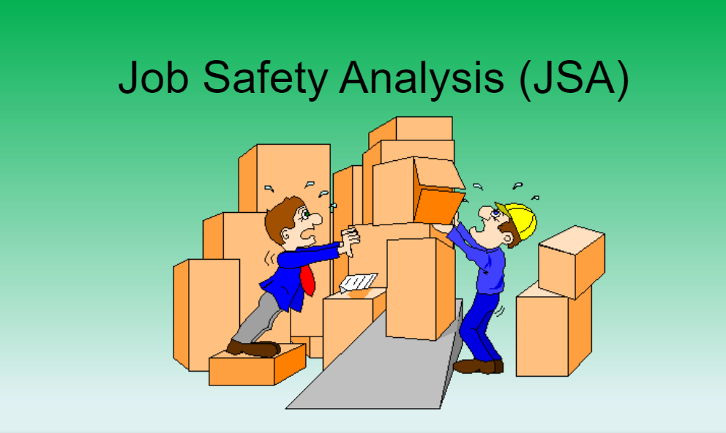

Slide 4
OBJECTIVES
Understand the benefits of JSAs
Understand the purpose and function
Know the developmental process
Determine when to develop
Identify responsibilities

Slide 5
What is job safety analysis?

Slide 6
DEFINITION
JSA: A systematic method of identifying hazards & control measures to safely perform a specific task.
Notes:
READ THE SLIDE

Slide 7
BENEFITS OF JSAs
Training of new employees
Accident investigation tool
Supervisor evaluation tool
Consistency in training
Injury reduction

Slide 8
Factors to be considered in setting a priority for analysis of jobs include:
☑ Accident frequency and severity: jobs where accidents occur frequently or where they occur infrequently but result in disabling injuries.
☑ Potential for severe injuries or illnesses: the consequences of an accident, hazardous condition, or exposure to harmful substance are potentially severe.
☑ Newly established jobs: due to lack of experience in these jobs, hazards may not be evident or anticipated.
☑ Modified jobs: new hazards may be associated with changes in job procedures.

Slide 9
General accepted measures
Eliminate the hazard
Contain the Hazard
Revise Work Procedures
Reduce the Exposure

Slide 10
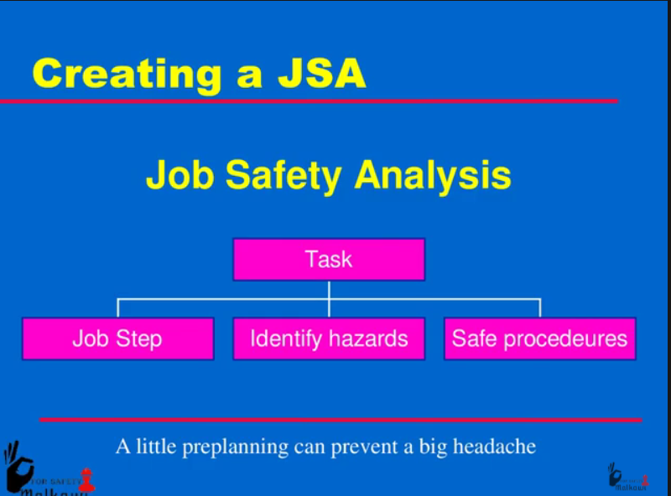
THE PROCESS
JSA:
Breaking down a job into steps
Identifying safety hazards at each step
Developing safe job procedures for each step

Slide 11
JSA PROCEDURE
STEP 1:
Select the job
JSA’s need to be completed when the following occurs: Fatalities, accident trends, new procedure or new job, or new equipment that has a hazard associated with it.
You can also perform JSAs based on Freq of Accidents, Severity of Accidents, Potential Severity.

Slide 12
JSA PROCEDURE
STEP 2:
Perform the Analysis Who is the most qualified person to conduct the JSA– Supervisors of the department where the jobs are performed.
Employees that actually perform the work are also qualified to conduct the JSA. Getting employees involved in the process helps to “sell the process”.
Observe performance of task, record each step, review the steps with employee who performed task.
Avoid common errors
Making the breakdown too detailed so that an unnecessarily large number of steps result or
2. Making the job breakdown so general that the basic steps are not distinguishable.
3. Make sure steps are in correct order.
TIP
The wording for each step should begin with an action word such as “remove”, “open”, “lift”, etc.

Slide 13
PROCEDURE Cont’d
STEP 3:
IDENTIFY HAZARDS Is there danger of striking against, being struck by, or otherwise making injurious contact with an object?
Can the employee be caught in ,caught by or between the objects?
Is there a potential for a slip or trip?
Can an employee strain himself/herself by pushing, pulling, lifting, bending, or twisting?
Is the environment hazardous to one’s health (toxic gas, vapor, mist, fumes, dust, heat or radiation)?

Slide 14
PROCEDURE Cont’d
STEP 4:
DEVELOP SOLUTIONS - Find a new way to do the job (determine the goal of the operation and select the safest method)
Change the physical conditions that created the hazard ( such as tools, equipment, work area layout)
Change the work procedure to eliminate the hazard
Reduce the frequency of its performance Implement administrative controls-Job Rotation
Use personal protective equipment to protect the employee.

Slide 15
PROCEDURE Cont’d
STEP 5:
Conduct a Follow-up Analysis: Supervisors should observe employees as they perform at least one job per month for which a JSA have been completed.
Purpose of the Observations: To determine if employees are following the job procedures as developed on the JSA.

Slide 16
PROCEDURE Cont’d
STEP 6:
Use of the Job Safety Analysis: Document use of. The JSA provides a learning opportunity for supervisor and employees.
New employees should be trained using the JSA and ALL employees should be trained at least annually.
JSA used for training on infrequent task performed by employees. Document use of.
The JSA is an incident/accident investigation tool. If a JSA has been completed on a task in which an incident/accident has occurred, the JSA should be reviewed & modified as needed.

Slide 17
PROCEDURE Cont’d
STEP 7:
Recordkeeping:JSA should be maintained in the department where they were created.
JSA should be readily accessible to employees.
Maintain inventory list of JSA’s that have been developed. The JSA index should include the name of task, date the JSA was completed & the date the JSA was last revised.

Slide 18
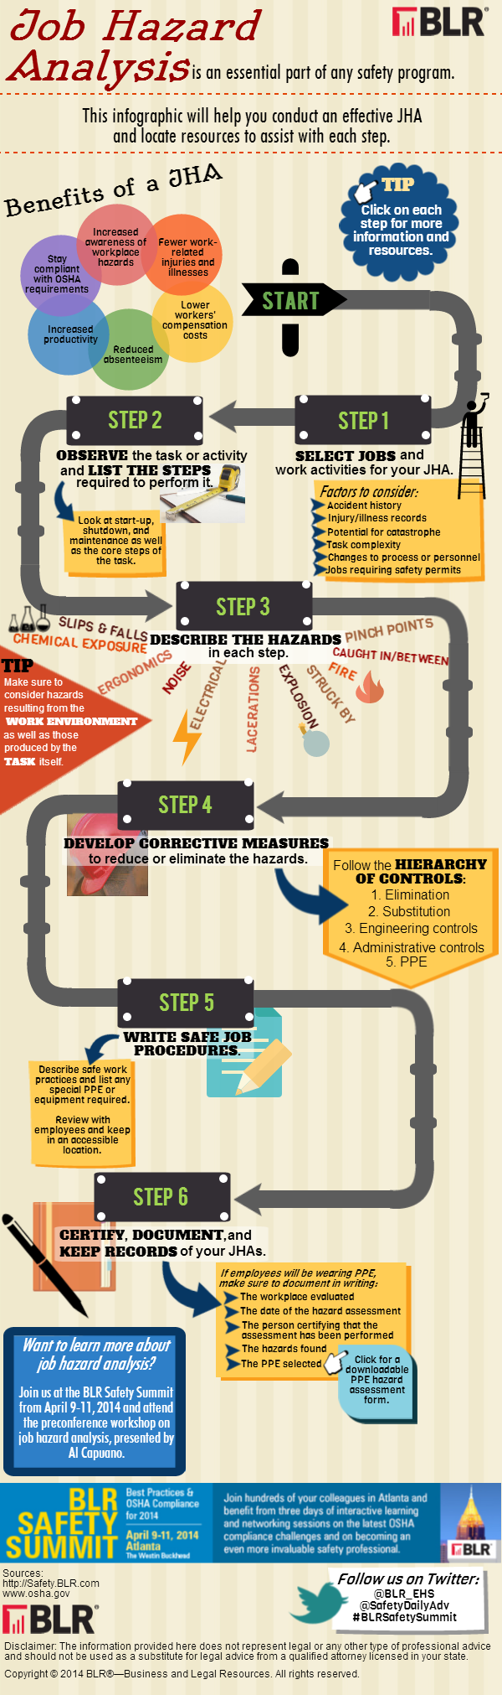

Slide 19
REVIEW JSAs...
During an accident/incident investigation process
Prior to conducting training
When work processes are changed or modified
JSAs
Notes:
If a job process is changed dramatically, it should be discussed with all personnel involved to determine the possible consequences of the changes.
Such discussions check the accuracy of the job safety analysis and involve personnel in the effort to reduce job hazards.

Slide 20
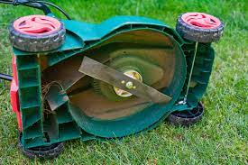

Slide 22
accident prevention

